Slide 1
The Impact of Academic Stress on Daily Habits During Midterm and Final Exam Periods
by Arda Demirci / 32189

Slide 2
PURPOSE OF THE PROJECT
Understanding the impact of academic stress during exam periods on daily habits by focusing on physical activity (step counts) and music listening durations.

Slide 3
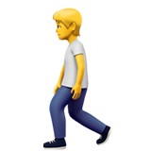

During the exam periods…
I noticed that I tend to walk more and listen to music more frequently.

Slide 4
Am I using these behaviors as coping mechanisms for stress?
My Hypothesis:
During midterm and final exam periods, stress leads to increased walking (higher step counts) and longer music listening durations compared to regular periods.

Slide 5


DATA SOURCES
Apple Health
Youtube Music via Google Takeout
Dates of Exam Periods
Exam periods are approximately assumed to occur in January, March, May, and November each year!.

Slide 6
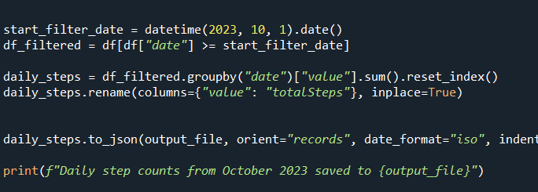
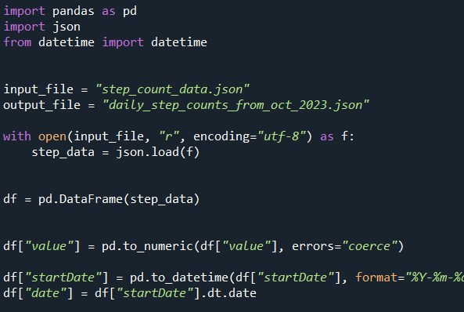
To simplify the large raw step count data from Apple Health,
I focused on daily step counts starting from October 2023 to make the dataset more manageable and relevant

Slide 7
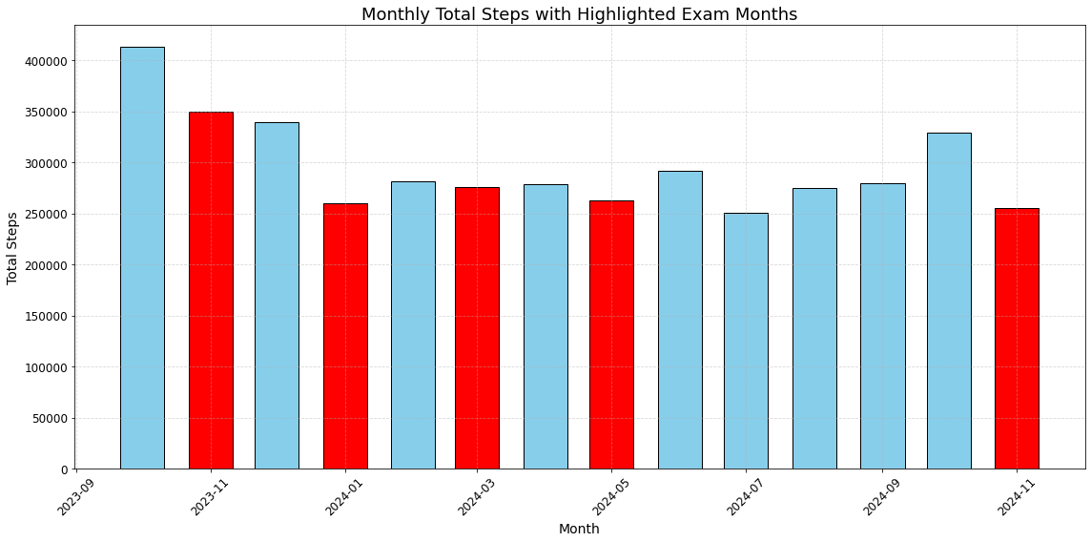
First, I wanted to examine how my daily step count changes over the months, so I created a bar chart.
The months marked in red represent exam periods. However, it seems that my step count does not vary significantly during these months.

Slide 8
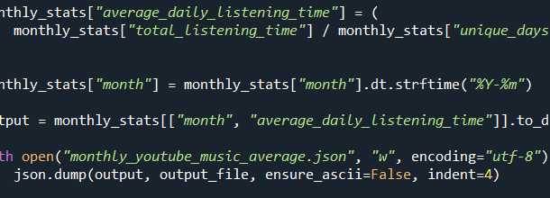
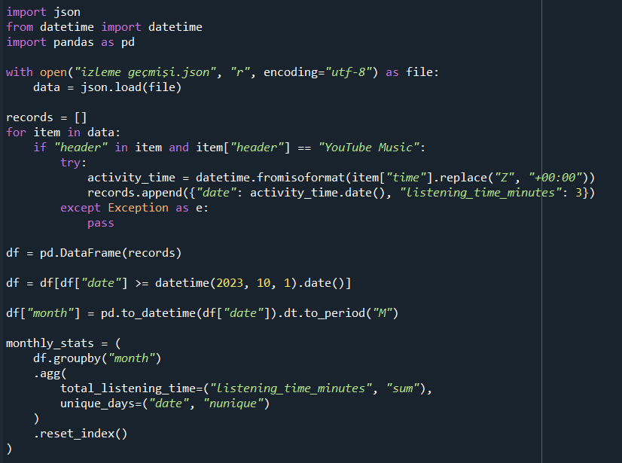
To simplify analyzing my raw YouTube Music data, I focused on 2024 and examined my monthly average music listening time.

Slide 9
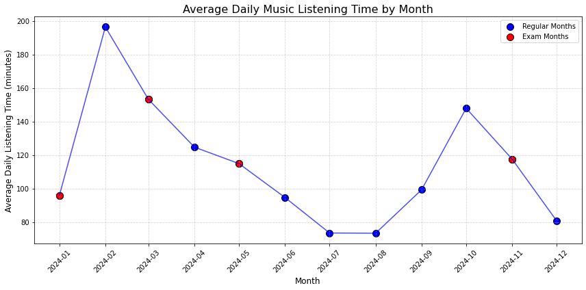
Then, I used a line chart to show my average daily listening time by month. Again, no significant relationship with exam periods was observed.

Slide 10
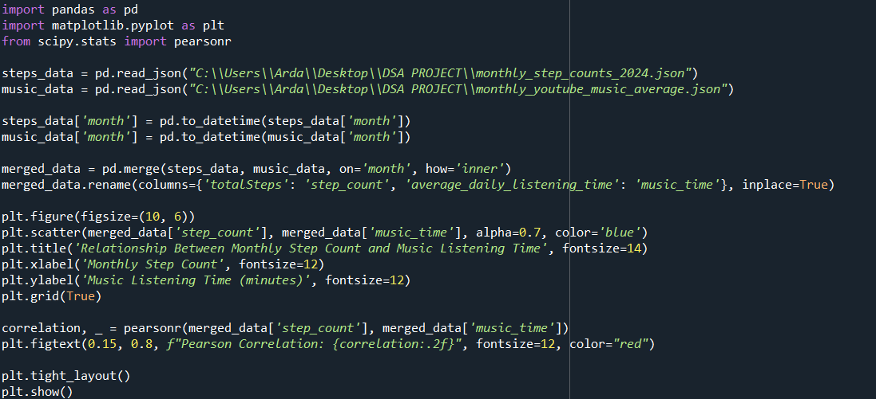
Finally, I began analyzing the relationship between step counts and monthly listening time using a scatter plot and calculating the Pearson Correlation to draw a conclusion.

Slide 11
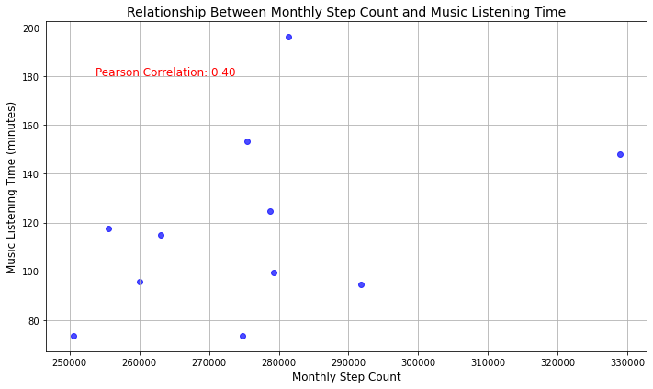
And I came across this scatter plot.

Slide 12
Pearson Correlation = 0.40
indicates a weak positive relationship, suggesting that step counts slightly increase with music listening time, but the connection is not strong or significant

Slide 13
In conclusion, I disproved my main hypothesis, as my step count is not related to exam periods, and my music listening duration also shows no significant connection with exam periods.
Additionally, the relationship between step count and music listening does not provide a clear result, indicating the need for further data and analysis.

Slide 14

Thank you for your time

